Slide 1
Bank Customer Churn Prediction
Group 7:
Shreyash
Ronil
Shubham
Namrata

Slide 2
Problem Statement
In the highly competitive landscape of banking industry, customer retention is very important for sustained growth and profitability. The abrupt loss of customers known as churn, leads to significant threat to a bank’s stability and market position.
To address this problem, we aim to develop effective customer churn prediction model

Slide 3
Benefits of Analyzing Customer Churn Prediction
Increase Profits
Improve Customer Experience
Optimize your products and services
Customer Retention

Slide 4
Project Roadmap
Data Collection
Data Preprocessing
Model Selection
Model Training
Model Evaluation
Prediction & Interpretation

Slide 5
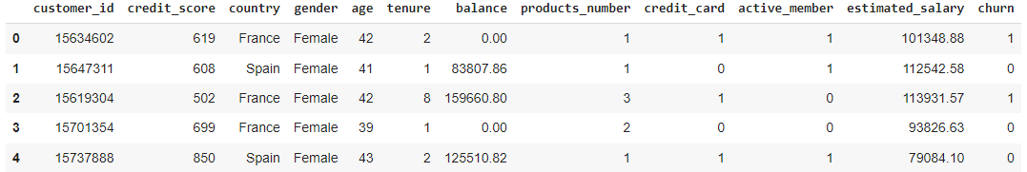
Data Collection
Source of Data: Kaggle

Slide 6
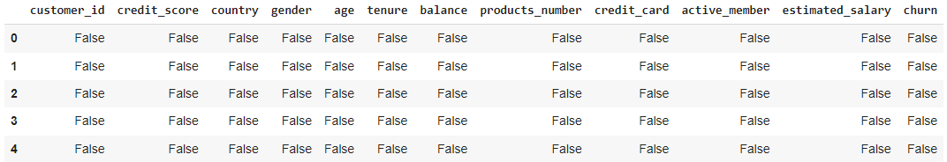
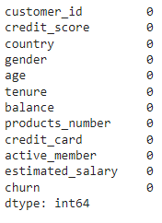
Data Preprocessing (EDA)
Check for NULL values in the dataset

Slide 7
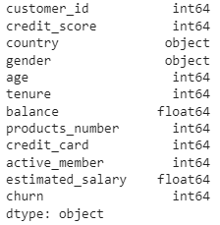
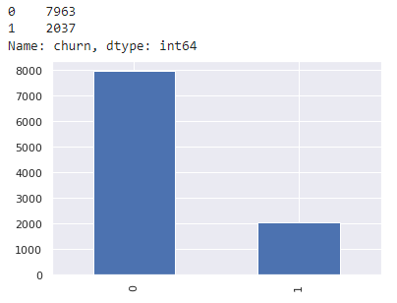
Checking Data types
Counting 1 and 0 Value in Churn column

Slide 8
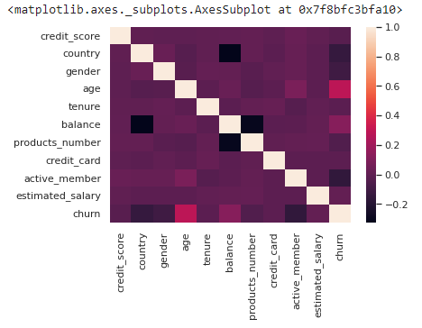
Correlation Matrix

Slide 9
Next Steps
Data Collection
Data Preprocessing
Model Selection
Model Training
Model Evaluation
Prediction & Interpretation

